Slide 1

Covid-19
Analysis & Prediction
Created by,
Group No. 103
Year of the Batch : 2019 | Dept. of CSE
University of Engineering and Management, Kolkata (UEMK)

Slide 2
Presented By,
Digbijoy Dasgupta [CSE 2nd year, Section : G, Roll no. 21]
Shreya Bose [CSE 2nd year, Section : G, Roll no. 56]
Raktim Karmakar [CSE 2nd year, Section : A, Roll no. 41]
Ishita Pahari [CSE 2nd year, Section : F, Roll no. 25]
Udayan Misra [CSE 2nd year, Section : H, Roll no. 75]
Abhishek Sharma [CSE 2nd year, Section : I, Roll no. 01]

Slide 3
What is COVID - 19?
Coronavirus disease 2019 (COVID-19) is a contagious respiratory and vascular disease caused by severe acute respiratory syndrome coronavirus 2 (SARS-CoV-2). The first case was identified in Wuhan, China in December 2019, though evidence suggests that the virus may have already been actively spreading months earlier in places such as Italy.
Common symptoms of COVID-19 include fever, cough, fatigue, breathing difficulties, and loss of smell and taste.Symptoms begin one to fourteen days after exposure to the virus.While most people have mild symptoms, some people develop acute respiratory distress syndrome (ARDS). ARDS can be precipitated by cytokine storms,multi-organ failure, septic shock, and blood clots. Longer-term damage to organs (in particular, the lungs and heart) has been observed.

Slide 4
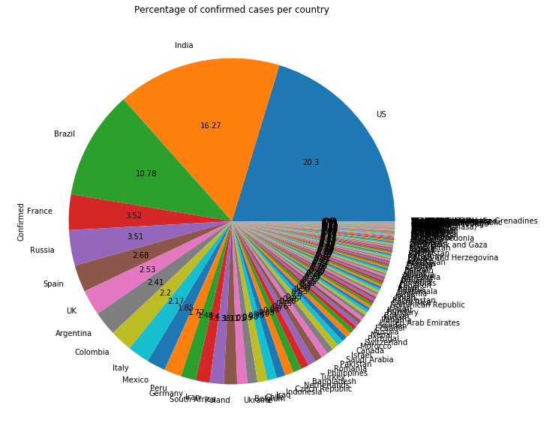
Affected Countries due to Covid-19
As per the data analysis, Covid-19 virus has spread out all over the world and affected 246 countries. Among the 246 countries the Top 5 countries those are affected vastly are,
United States of America (20.3%) of the world’s statistics. Second worst condition is of India, holding the share of 16.27% and the third one is Brazil, holding the 10.78% share of the world’s total confirmed cases tally. After that France and Russia showing their share percentage of 3.52 and 3.51 respectively.

Slide 5
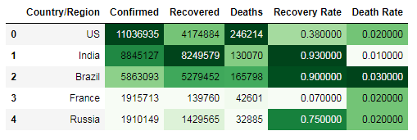
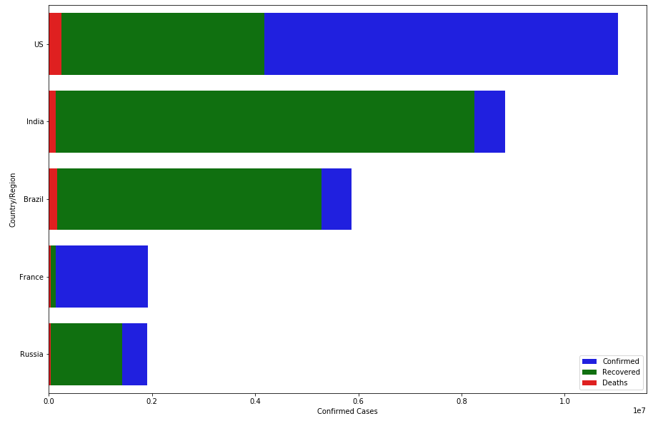
Recovery Rate and Death Rate Analysis
USA Highest number of Confirmed cases
USA Highest number of Death Cases
India Highest number of Recovered cases
India Highest Recovery rate (0.93)
Brazil Highest Death Rate (0.30)
France Lowest Recovery rate (0.07)
India Lowest Death Rate (0.01)
The Graphical representation is also reflecting the same stats.

Slide 6
Let’s see what was the origin of this virus...

Slide 7
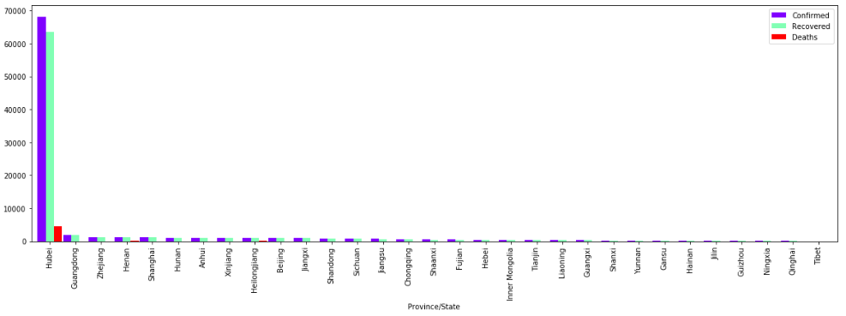
Hubei Province : CHINA
Hubei Province of China was the origin of the Covid-19 pandemic, as we can see that No. of confirmed cases for Hubei province was at 70000 at the month of February, 2020

Slide 8
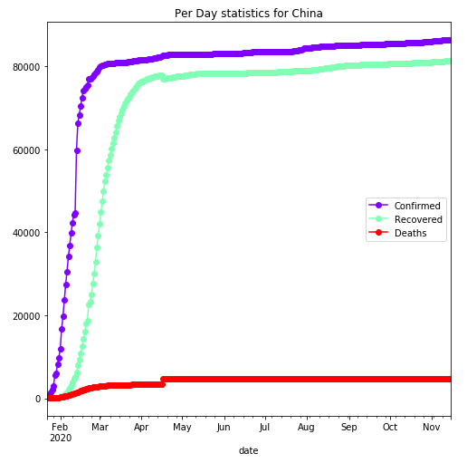
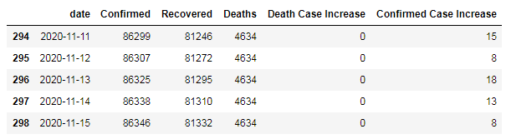
Statistics for China
In the month of February and March China crossed the mark of 80000 in mere 28 days span and after that the cases were stagnanted and in the past 9 months the confirmed cases tally reached the mark of 3700 only. But how did China make this thing so easily?
Let’s Find out...

Slide 9
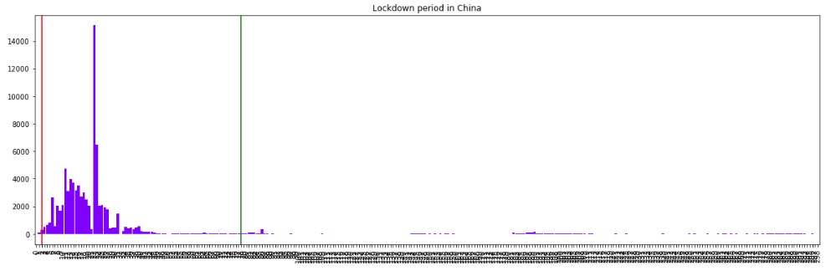
China’s Saviour : THE LOCKDOWN PROCESS
The Lockdown was imposed on 23rd of January and revoked on 8th of April. In between this China have maintained all the safety measures to fight against this spread out. The well equipped hospital system and the medical departments of China and also the Government has done a fantastic job stop the spread out of the virus.

Slide 10
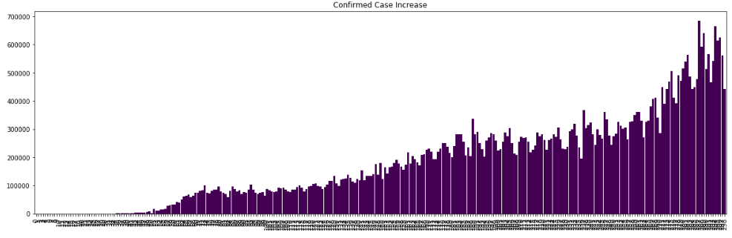
Worldwide Statistics of Daily Increment of cases
The Daily increment in the confirmed cases are exponentially increasing, which shows how worse the situation is going to be and what we gonna face in the future days unless and until the vaccination starts.

Slide 11
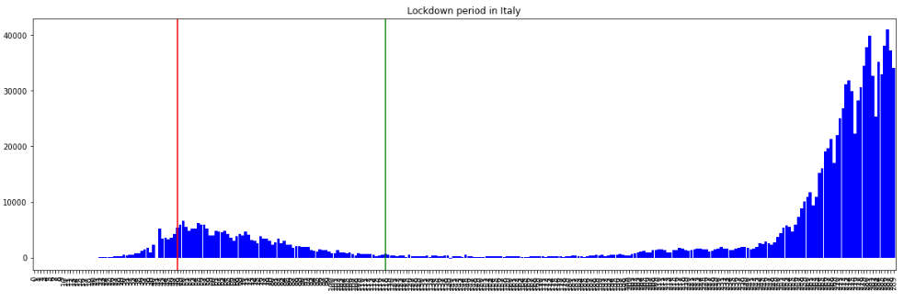
Suddenly everything changed for ITALY Epicenter 2
As per the datas collected from various resources, we analysed the fact that the LOCKDOWN was the saviour for Italy and everything was under control. But suddenly in the last 20 days the daily rise in the confirmed cases reported 4 times the previous highest one and it seems that Italy is in deep deep trouble to control the spread out.

Slide 12
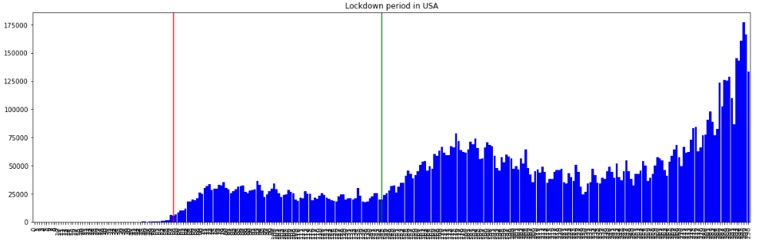
The Giant fell down this time : USA Epicenter 3
United States of America imposed lockdown on 19th March, 2020 when they were at the initial stage and the cases were 10000. After the lockdown implementation the cases were raised to 40000 daily and it was continued 87 days but the daily cases were not increased beyond 40000. At this moment Donald Trump decided to open USA and re-open the economy as they faced a decrement of 4.5% GDP, and this will cost the country hugely if the economy is not opened yet. As the lockdown revoked on 13th June, 2020, the cases are drastically increasing and creating a new record every day. As we can see that after the revocation of lockdown the condition became worse for USA. They have seen 80000 cases daily, and the tally is still increasing. Unfortunately, for USA the lockdown period is successful to some extent and to prevent the daily exponential increment but on the same side, it did not make the curve downward or even flattened

Slide 13
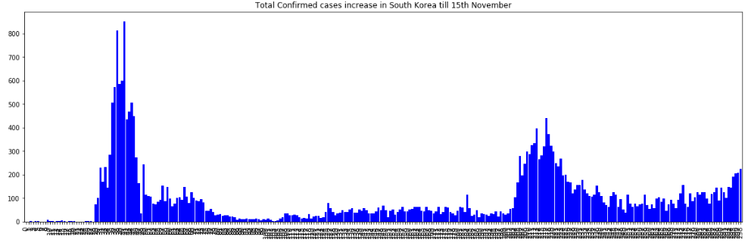
The Role Model : South Korea
In the recent times if we check out the no. of Confirmed case Increase, we can find that the cases are bearly minor as compared to the whole world. And the Death Case Increment is now down to 0 in the recent times. Which shows that SOUTH KOREA is able to fought against the virus with minimum casualties of 494 till 15th November, 2020. Even the highest number of cases were 800, which shows how good South Korea handled the situation and prevent the spread out. Total number of affected people in South Korea is 28769 as per the datas of 15th November, 2020

Slide 14
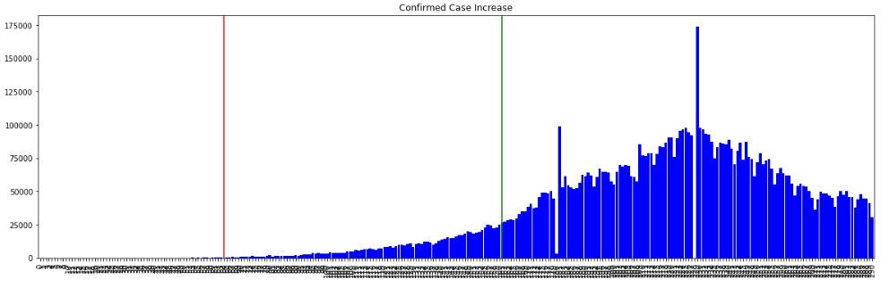
INDIA against Covid-19
After watching the world suffering from the virus, India has take precaution earlier and imposed lockdown on 23rd march, 2020. After that the cases were increasing in a daily basis and exponentially, and the toll reached to 40000 mark. At that time the government decided to revoke the lockdown. As a result the cases were raised to 2500000 (As of the data of 15th November, 2020). India is having the worst condition in the world. The cases are increasing 60000 daily. There is no sign of flattening the curve rather it is exponentially increasing and the curve is obtaining more and more steep slope day by day. INDIA, IN THE PERSPECTIVE OF LOCKDOWN WAS TOTALLY UNSUCCESSFUL, AND BECAME 2nd HIGHEST INFECTED COUNTRY IN THE WORLD

Slide 15
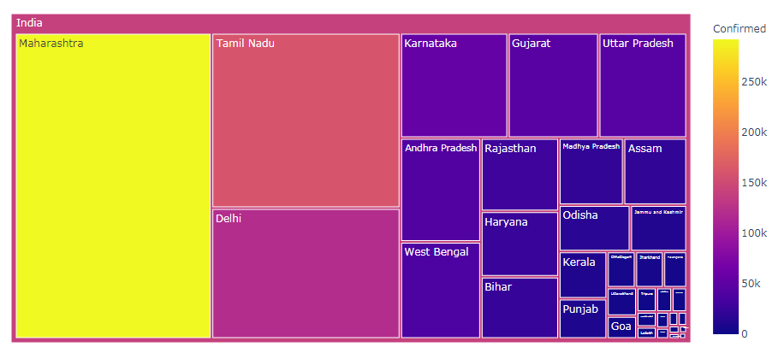
Statewise Analysis and Visualization

Slide 16
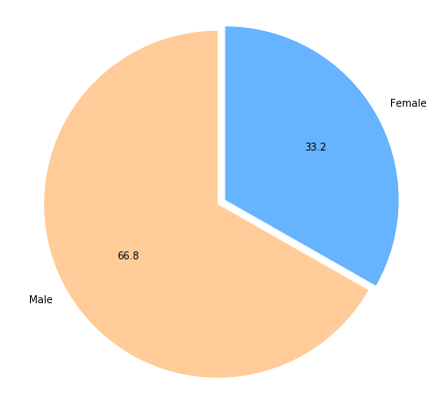
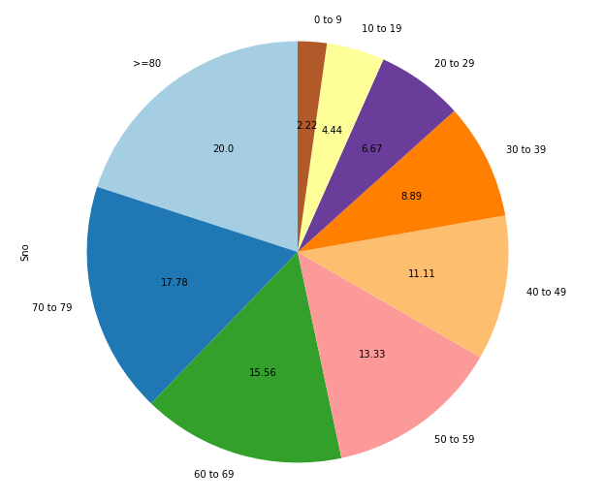
Gender and Age-group wise Analysis
Gender wise analysis Age Group wise analysis

Slide 17
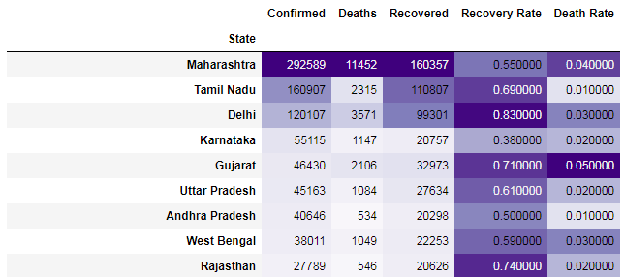
State Wise Table : Recovery Rate and Death Rate
MAHARASHTRA is having the most Confirmed cases, Recovery cases and Death cases
DELHI is having the highest Recovery rate and GUJARAT is having highest Death rate

Slide 18
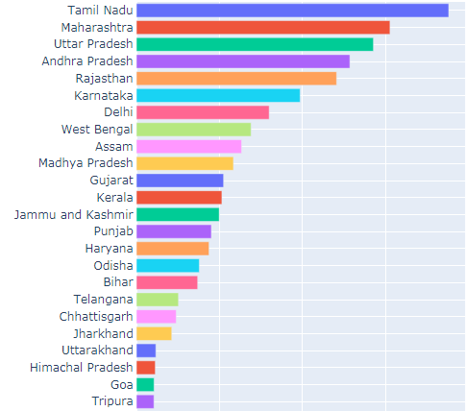
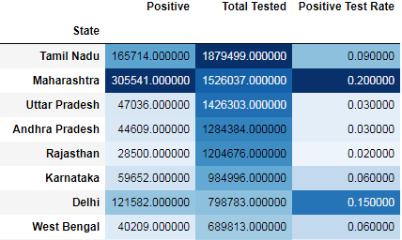
Testing Done Statewise and Positive Test Rest
As per the statistics of positive test rate of Maharashtra we can easily identify that how worse the situation is for Maharashtra. A survey shows that every household has a Covid patient and the hospital beds are running out.

Slide 19
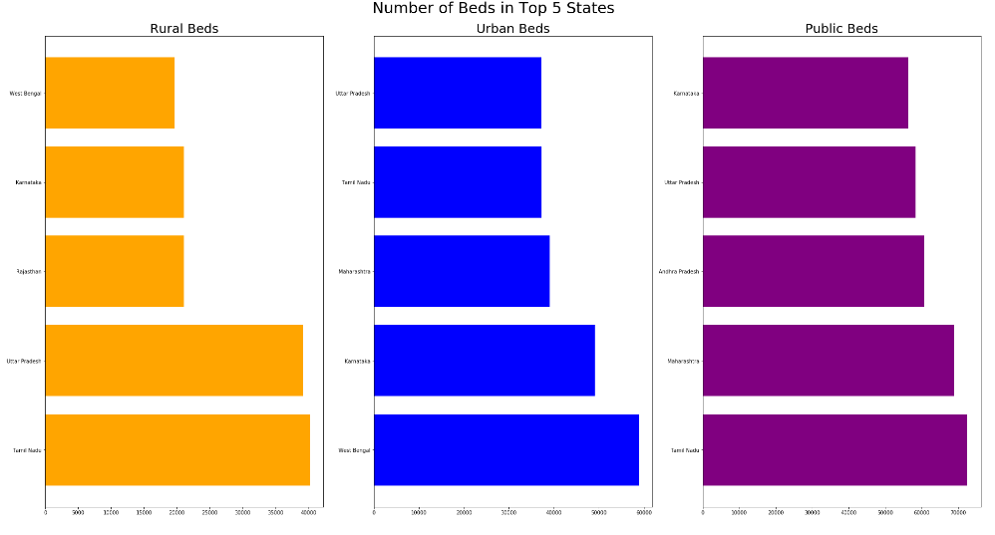
Top 5 well equipped states with Hospital Beds

Slide 20
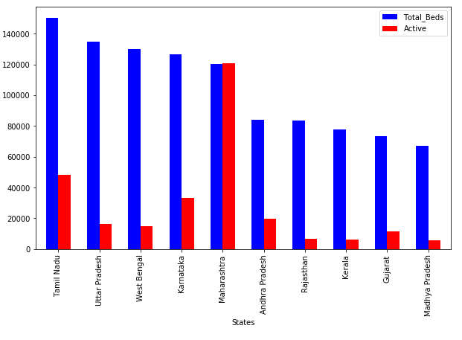
Current Situation of Hospital Beds

Slide 21
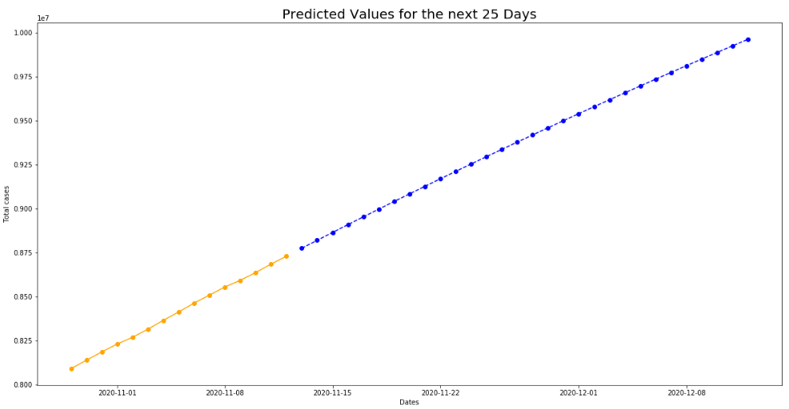
Prediction for India [for the next 25 days]

Slide 22
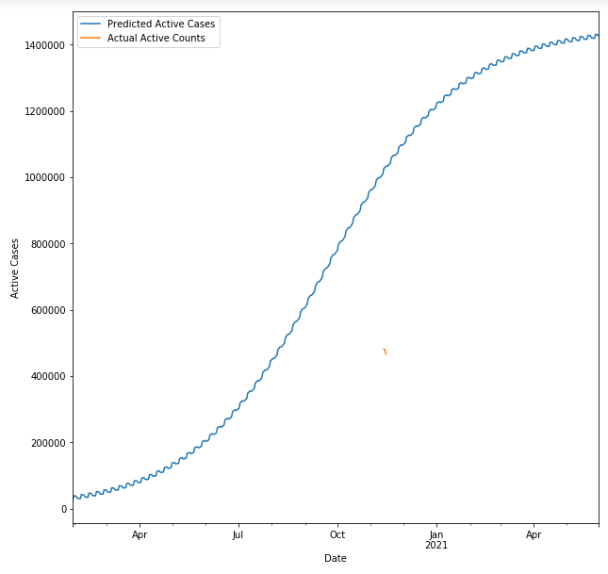
Final Prediction for India as per the data collected upto 15th Nov. 2020
Investigations have been made on the issue of COVID-19 pandemic spread in India in the current challenging scenario. Trend knowledge has been observed with the help of recovery rate and case load rate obtained for the data available. The various strategies implemented as lockdown, quarantine of population have played a significant role in reducing the risk of spread of epidemic. This study predicts that when the caseload rate gets lesser than recovery rate, there after COVID-19 patients would start to decline.

Slide 23
Conclusion
For the countries like India, USA, Brazil, they are the worst candidates of this pandemic, and the had suffered the most and still suffering. If we have to fought against the virus, we have test the samples in a huge number. Testing is the only without lockdown the country, as Japan is doing. Testing is the most essential thing, without which we cannot trace the curve and it will increase with a high slope.
According to the prediction, India will be seeing the flattened curve of daily confirmed cases in the month of March and April, 2021. And at that moment the country will have all total 50000000 confirmed cases, which will be the nightmare for the country. If the vaccine is available then it will be another thing, but if the confirmed cases are increasing at the rate of 60k to 70k, and eventually it will increase to 90k to 100k, 1/3 of the total population of India will be affected.

Slide 24
Bibliography
http://weekly.chinacdc.cn/news/TrackingtheEpidemic.htm
Hong Kong Department of Health: https://www.chp.gov.hk/en/features/102465.html
Macau Government: https://www.ssm.gov.mo/portal/
Taiwan CDC: https://sites.google.com/cdc.gov.tw/2019ncov/taiwan?authuser=0
US CDC: https://www.cdc.gov/coronavirus/2019-ncov/index.html
Government of Canada: https://www.canada.ca/en/public-health/services/diseases/coronavirus.html
Australia Government Department of Health: https://www.health.gov.au/news/coronavirus-update-at-a-glance
European Centre for Disease Prevention and Control (ECDC): https://www.ecdc.europa.eu/en/geographical-distribution-2019-ncov-cases
Ministry of Health Singapore (MOH): https://www.moh.gov.sg/covid-19
Italy Ministry of Health: http://www.salute.gov.it/nuovocoronavirus
Picture courtesy : Johns Hopkins University dashboard

Slide 25
Thank You!
Stay Home! Stay Safe!
Wear Mask and keep Social Distancing
------

